Slide 1
Project Name – Global Business Insights 360
Tools used :-
For Data Visualization:- Power BI Software
For Data Collection and Retrieval :- MySQL Workbench
For Miscellaneous Files import and analysis :- Microsoft Excel
For Publishing and Sharing Dashboard:- PowerBI Service (app.powerbi.com)

Slide 2
Problem Statement:-
Global Business Insights 360
AtliQ wants to make data driven decision
making as a part of their work culture
and taking their first big step towards
that by embedding a Power BI tool in the organisation

Slide 3
Objective
Enable quick Insights for business across markets and data driven decision making.
Enable 'Start the day with analysis’ Practice

Slide 4
Outcomes
A functional dashboard is implemented with key business metrics as specified.
Users are able to use the tool in their business review meetings and in their decision making process such as customer negotiation, new product launch, marketing, promotions, finance budgeting etc.

Slide 5
Project Goals
Who ?
Executives, Finance, Supply Chain, Sales & Marketing teams
What ?
Unlock insights and enable data driven decision making
When/Where ?
From FY 2018 to Q2 of FY 2022
Why ?
care about it?

Slide 6
Dashboard
Finance View
Sales View
Marketing View
Supply Chain View
Executive View

Slide 7





Customer
Consumer
AtliQ Hardware's

Slide 8
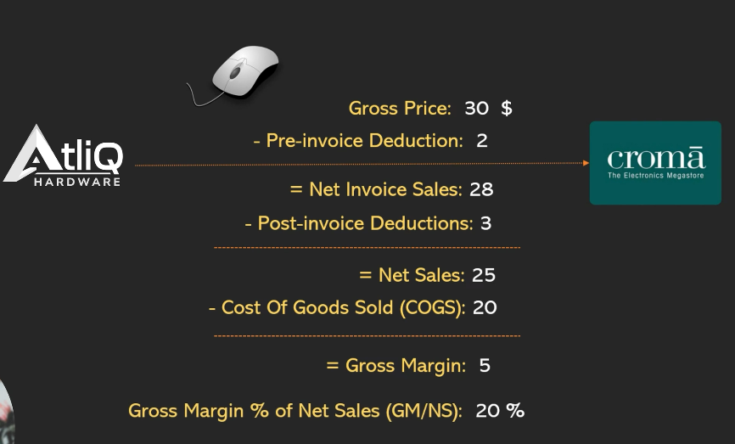
Profit and Loss Statement

Slide 9
Fiscal Year Duration
We are analysing around 1.8 Million Rows Data spanning across 15 Tables in our Data Model
AtliQ Hardware's has a Fiscal Year From months:-
Sept 2017 to Aug 2018
Sept 2018 to Aug 2019
Sept 2019 to Aug 2020
Sept 2020 to Aug 2021
Sept 2021 to Aug 2022
FY - 2018
FY - 2019
FY - 2020
FY - 2021
FY – 2022 Estimate
Actual Sales Data available till Dec 2021
Forecast Data Available till Aug 2022

Slide 10
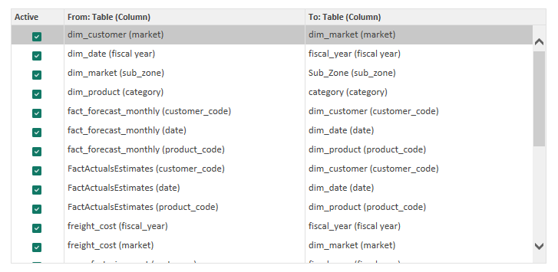
Relationships:- (One to Many)

Slide 11
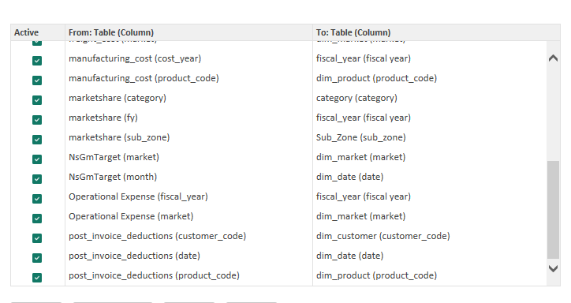
Relationships:- (One to Many)

Slide 12
Dashboard details:-
Finance View : -
P&L (Profit & Loss Statement) matrix
KPIs (Key Performance Index)
Area Chart (Comparison between Selected year and Benchmark)
Top/ Bottom Products/ Region wise analysis based on P&L values
Filters based on Benchmarks, Regions, Customers, Segments/Categories/Products

Slide 13
Dashboard details:-
Sales View : -
Customer/Product wise Performance Matrix table
Scatter Chart showing Performance of various Customers
Unit Economics – Doughnut Chart (Proportions or Section wise Performance)
Filters based on Benchmarks, Regions, Customers, Segments/Categories/Products, Fiscal Years and Quarters.
Switch between scatter chart to matrix table for Customer Performance.

Slide 14
Dashboard details:-
Marketing View : -
Product/Region wise Performance Matrix table
Scatter Chart showing Performance of various Segment/Category/Product
Unit Economics – Doughnut Chart (Proportions or Section wise Performance)
Filters based on Benchmarks, Regions, Customers, Segments/Categories/Products, Fiscal Years and Quarters.
Switch between (NP% and GM%) metrics in scatter chart for analysing Performance based on Products

Slide 15
Dashboard details:-
Supply Chain View : -
Matrix table for analysing Supply Chain Metrics w.r.t Customers and Products
KPIs displaying performance of Supply Chain Metrics (FCA%, NE, Abs Error)
Line and Clustered Column Chart for comparison between Supply Chain Metrics (FCA%, FCA% LY, Net Error)
Filters based on Regions, Customers, Segments/Categories/Products, Fiscal Years and Quarters.

Slide 16
Dashboard details:-
Executive View : -
Ribbon Chart for displaying Market Share % data of Rivals and AtliQ
Line and Clustered Column Chart showing Performance of various metrics limited to Atiq
Key Insights by Subzone Table
Filters based on Benchmarks, Regions, Customers, Segments/Categories/Products, Fiscal Years and Quarters.
Doughnut Chart for Revenue Contribution by different metrics

